Slide 1
Soft Guided Glider
Andrew Brown, Connor Crabb-Thompson, Jeremy May, Mark Campbell
Notes:
Jeremy

Slide 2
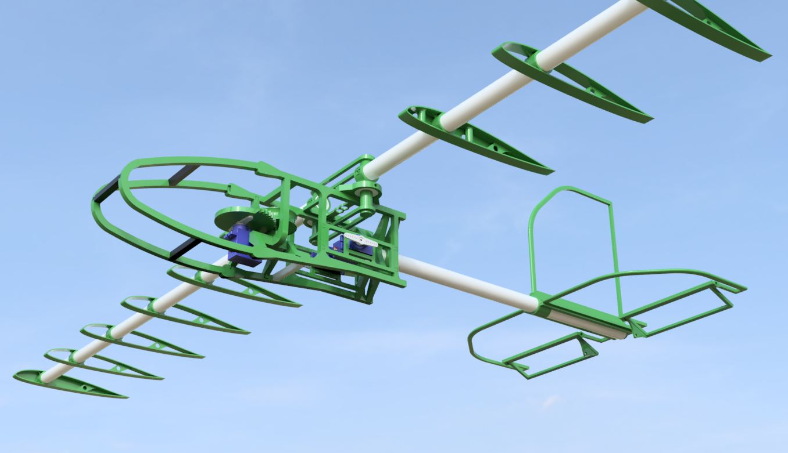
Introduction
Build a glider that can deliver vital supplies to people in need when they are in hard to reach locations
Notes:
Jeremy

Slide 3
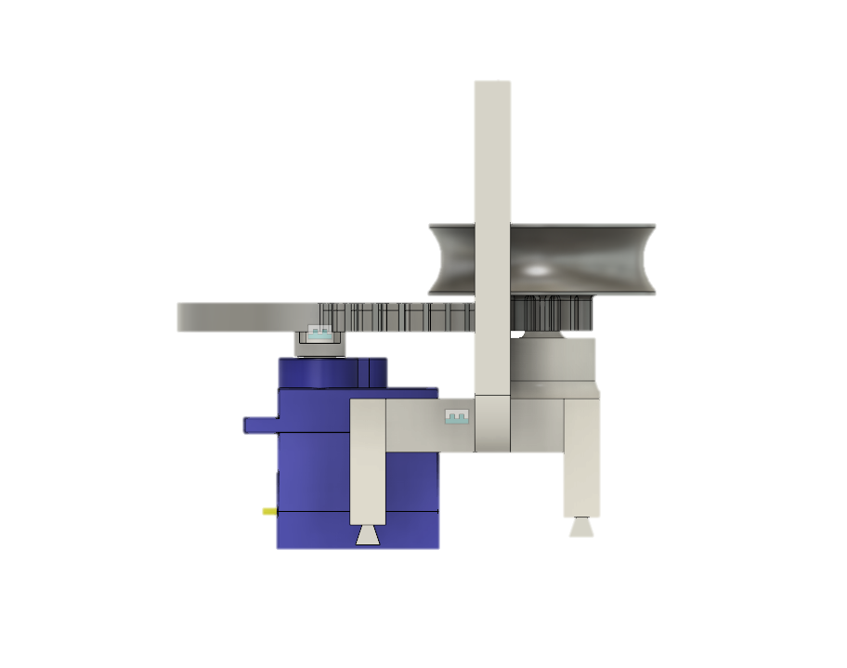
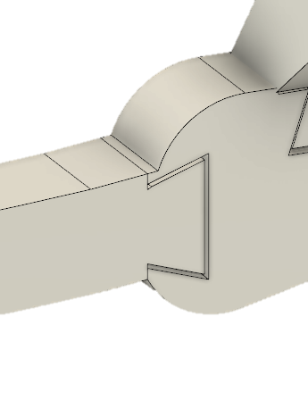
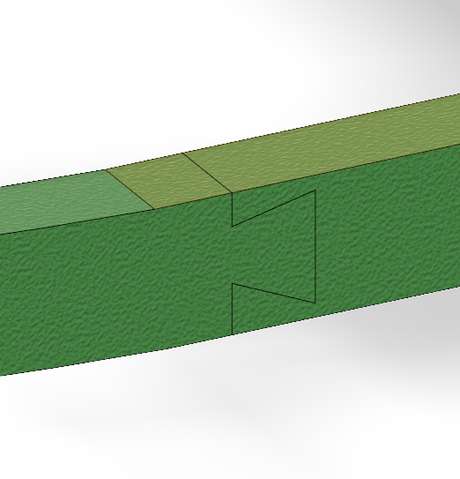
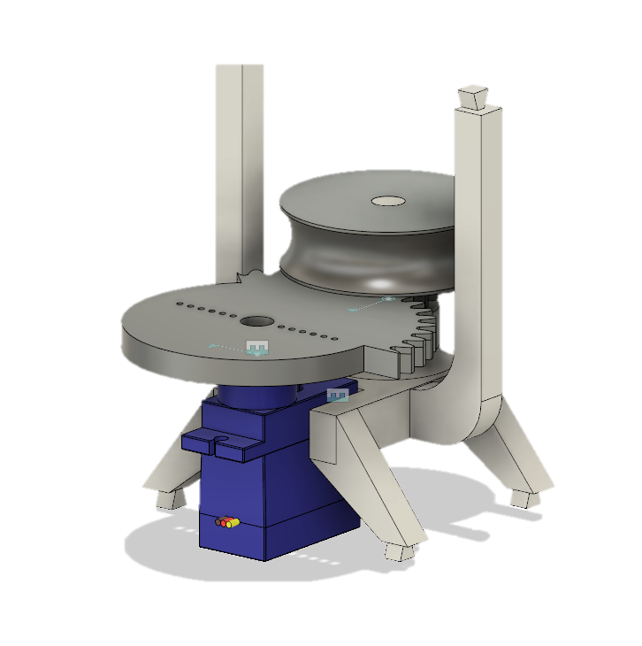
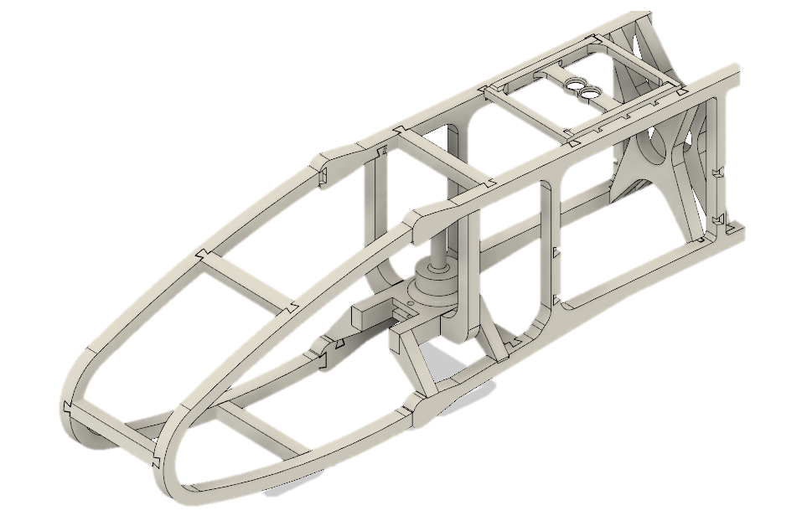
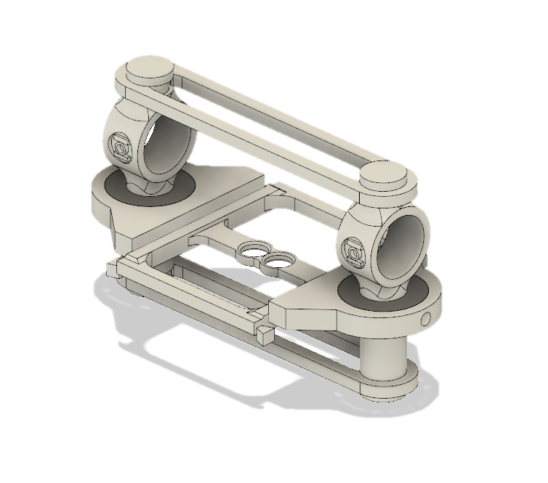
Mechanical Design
Notes:
Andrew

Slide 4
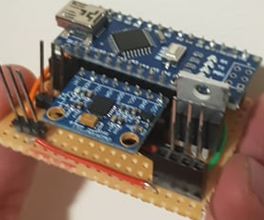
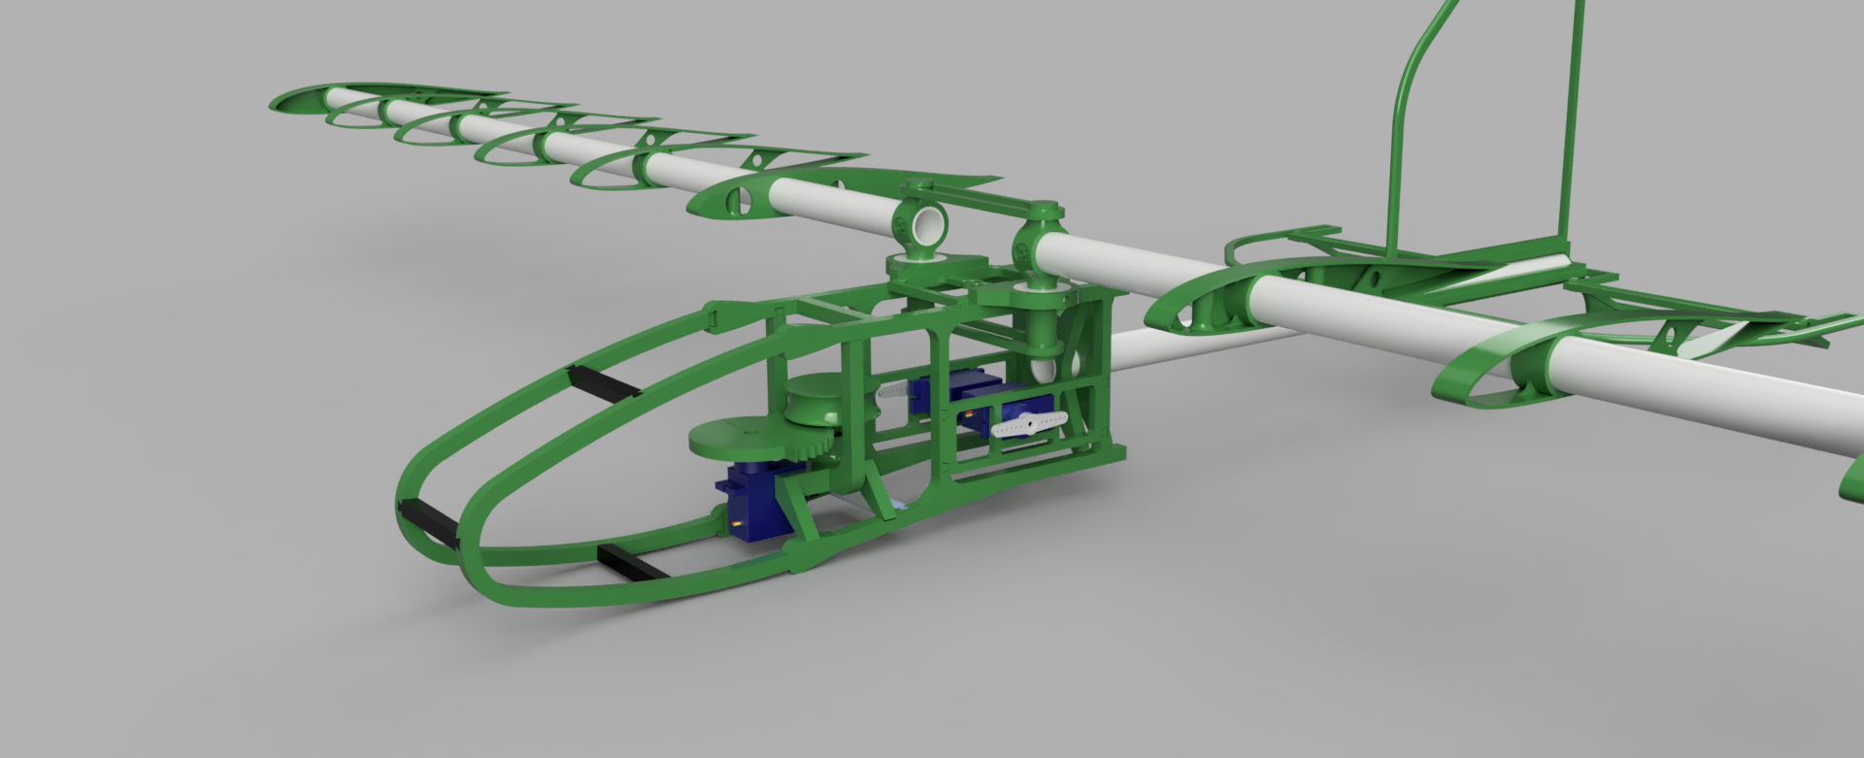
Integrating Electronics
Servo Housing has been built into system and connected to elevators
Circuitry has been miniaturised onto Veroboard
Notes:
Connor

Slide 5
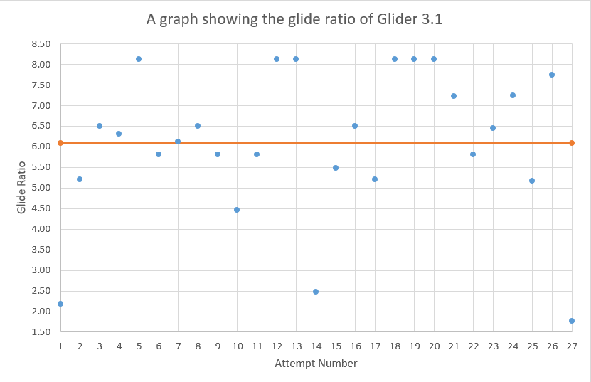
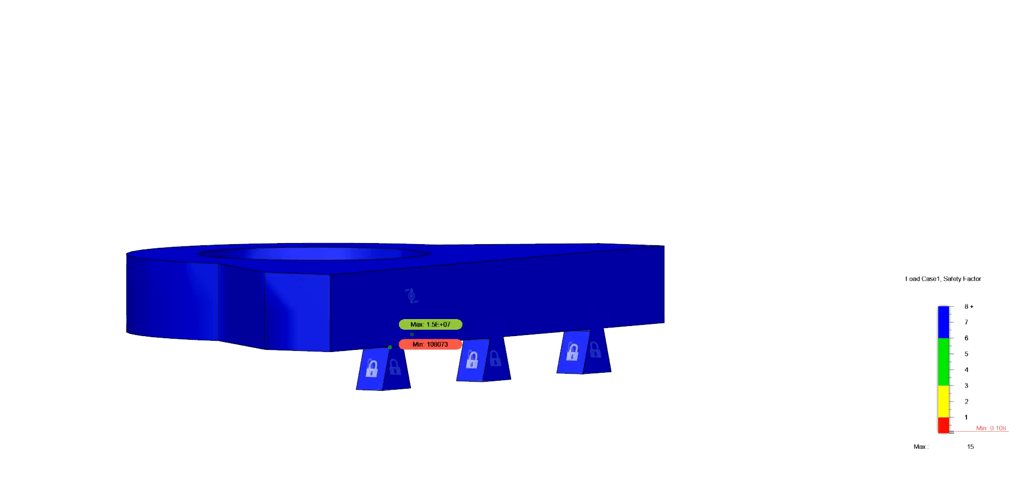
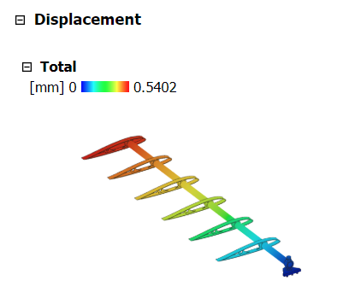

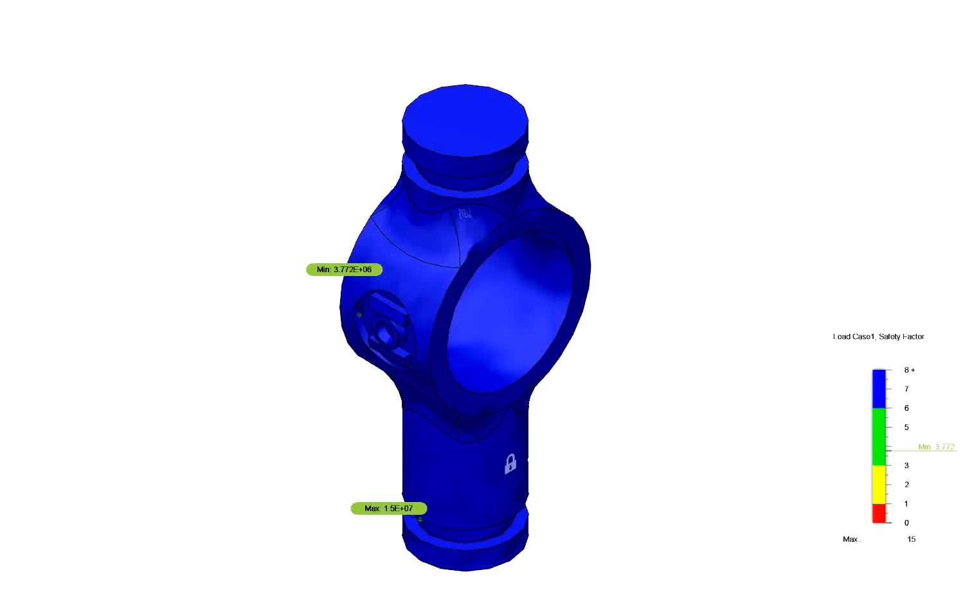
Testing and Analysis
Analysis: Finite element analysis
Testing:
Gliding testing
Compliancy testing
Steering testing
Notes:
Mark

